Slide 1

Loaders:
Programs you write are useless if it just sits on the disk !

Slide 2

Why do we even need a Loader ?
An Object Program contains the translated instructions and data values, but it lacks a physical place to stay.
Program → translate into machine code → waiting to be placed in memory
So, there is a need of system program which actually loads the object program into memory and ensures it executes.
If the code isn't in the RAM, the CPU doesn't even know it exists.

Slide 3



The 4 Non – Negotiables:
Memory Allocation:
Symbolic Linking:
Address Relocation:
It identifies and reserves the necessary memory space to ensure the program runs smoothly.
The loader examines and resolves symbolic references found within the object modules.
It adjusts address references to align with the newly assigned memory locations during runtime.
Code Loading:
Finally, the loader transfers the machine-level instructions from the object modules into the allocated memory, setting the stage for the program to execute.

Slide 4
The Absolute Loader
A Classic Example and the Simplest form of Loader

Slide 5
Single Pass Design :
The address written in file == address where the code should go.
The Absolute Loader is the simplest version of this tool. It doesn't worry about relocation or linking.
Performs all the 4 functions of the loader
1

Slide 6
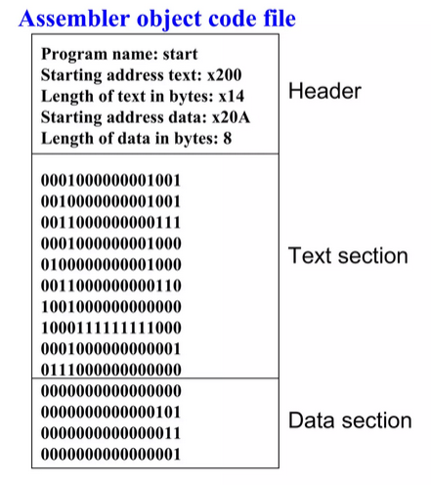
The Absolute Loader
Loads Program at memory location x200
Header record is checked if the correct program is being loaded or not.
Read each text record -> move it to indicated Address
IF EOF is encountered, Jump to specified address to begin execution

Slide 7
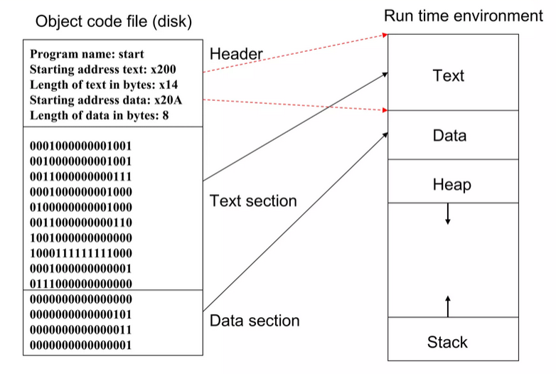
How Object Code is loaded into Memory:

Slide 8
A Hypothetical Example
Object Record Type | Address Field | Hex Content | Target Memory
H (Header) | 002000 | MY_PROG | Initializes Loader
T (Text) | 002000 | 041122 | Addr 2000 → 04 11 22
T (Text) | 002003 | 334455 | Addr 2003 → 33 44 55
E (End) | 002000 | — | Jump to 2000

Slide 9
Advantages
Disadvantages
Simple, easy to design and Implement
There is no memory limit, more core memory is available to user.
Programmer must tell assembler the address where program is to be loaded.
When subroutines are referenced, their addresses must be specified.

Slide 10
How does a computer start if there is no loader in memory yet?

Slide 11



The Bootstrap Loader:
Restart
Address 0
Load OS
When the computer is first turned on, the Bootstrap is the first code to execute.
The bootstrap program itself begins residing at memory address 0.
It typically loads the Operating System into memory starting at address 80.

Slide 12
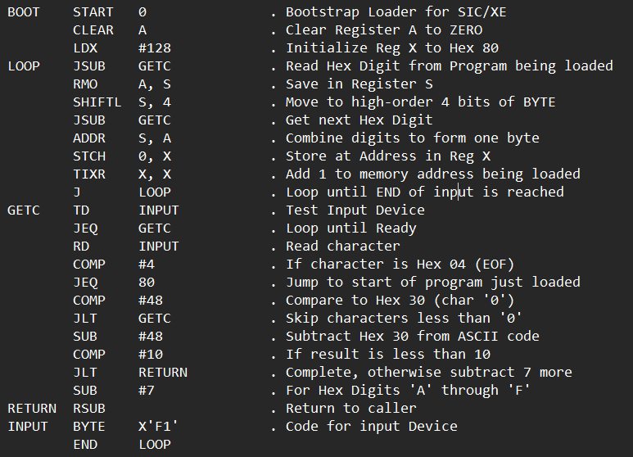
SIMPLE BOOTSTRAP LOADER

Slide 13
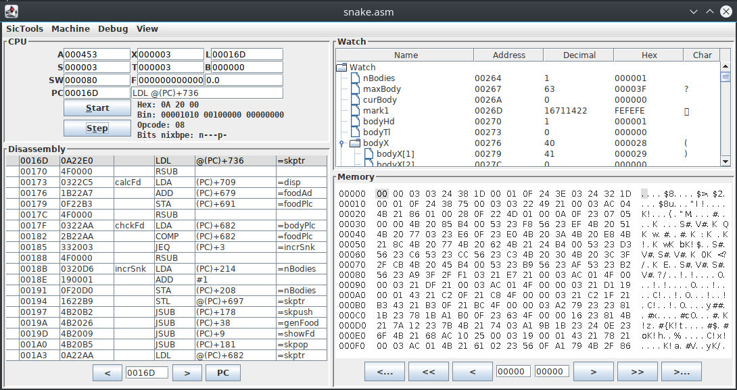

Slide 14

! Questions { THANK YOU }

